Slide 1

LSTM GRU
열려라 참깨
2017202021 김재원 2017202012 노선영
2015722014 오형근 2018202105 임서진
2017202053 장준혜

Slide 2
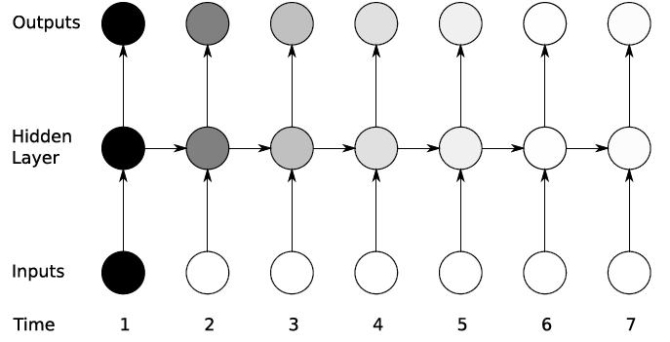
Recurrent Neural Network(RNN)
weakness
Over time, historical information becomes diluted and forgotten
(Vanishing Gradient Problem)
Long Short-Term Memory(LSTM)
Gated Recurrent Unit(GRU)

Slide 3
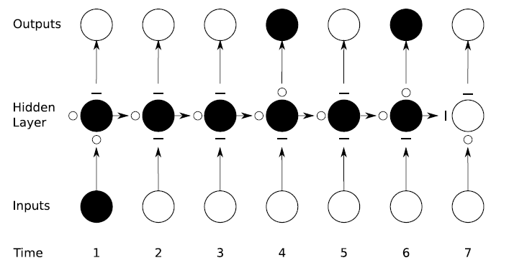
Long Short-Term Memory(LSTM)
gate
In a basic RNN structure, gate is installed
to control the input and output of information
in the path through which it flows to control
the retention of historical information

Slide 4
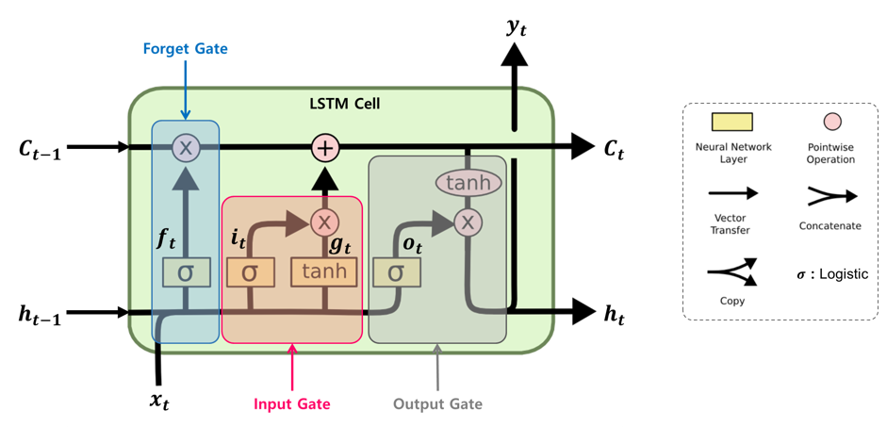
Long Short-Term Memory(LSTM)
Structure of LSTM Cells
Long-term state
Short-term state

Slide 5
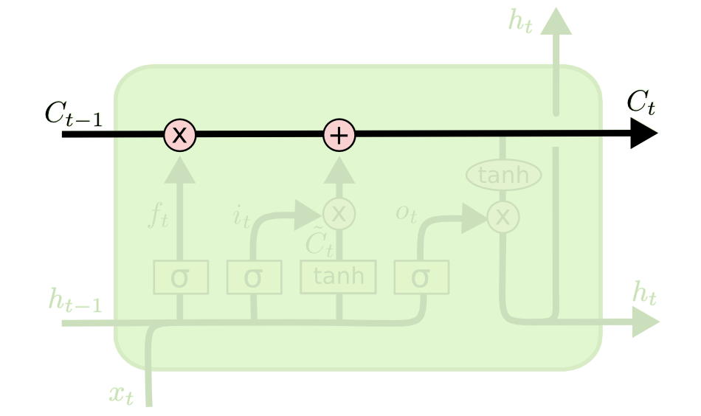
Long Short-Term Memory(LSTM)
Core Structure of LSTM Cells
Long-term state

Slide 6
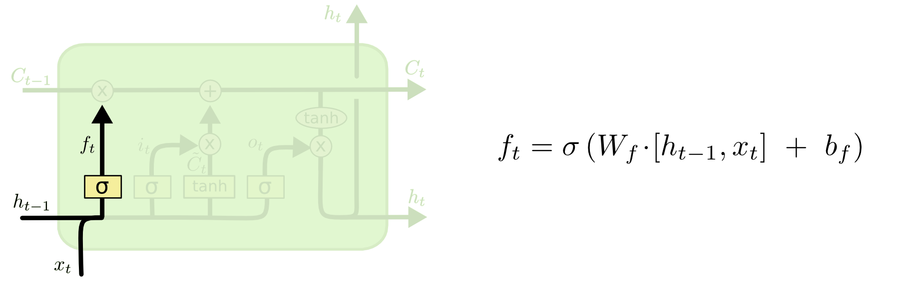
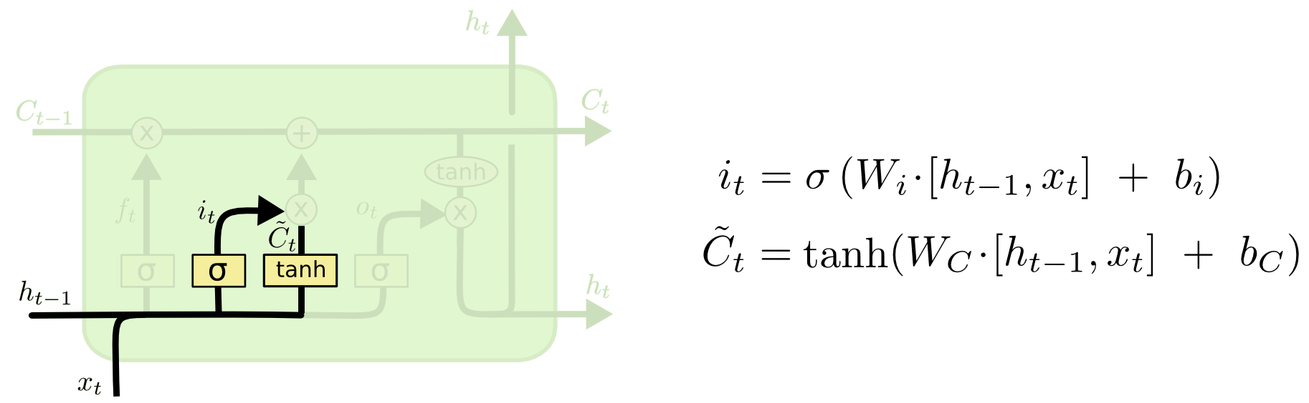
Long Short-Term Memory(LSTM)
LSTM step-by-step algorithm
Forget gate layer
Input gate layer

Slide 7
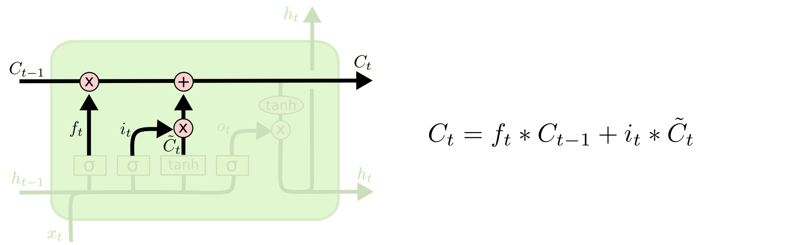
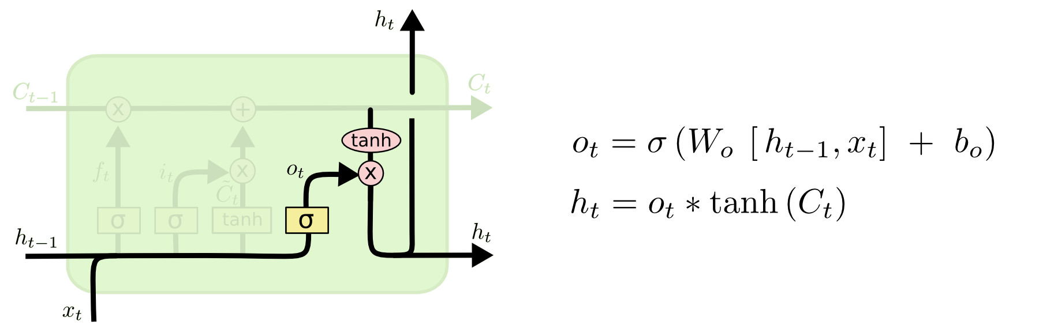
Long Short-Term Memory(LSTM)
LSTM step-by-step algorithm
Cell state update
Output gate layer

Slide 8
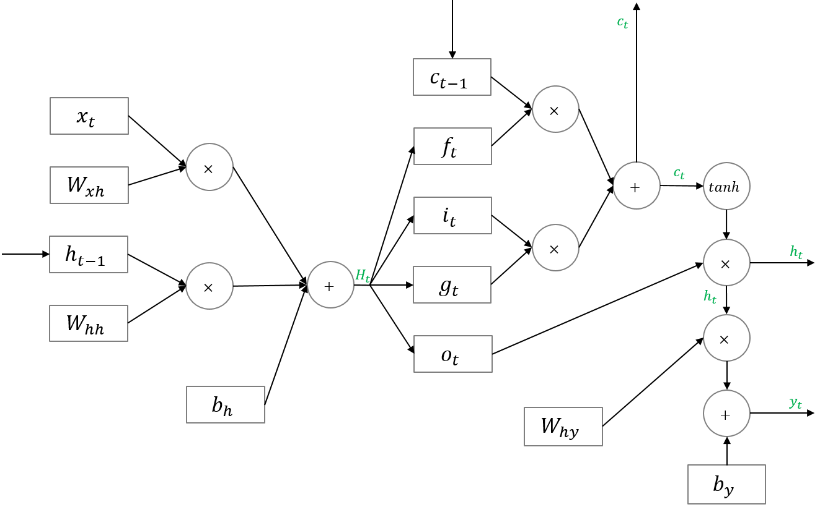
Long Short-Term Memory(LSTM)
Forward propagation

Slide 9
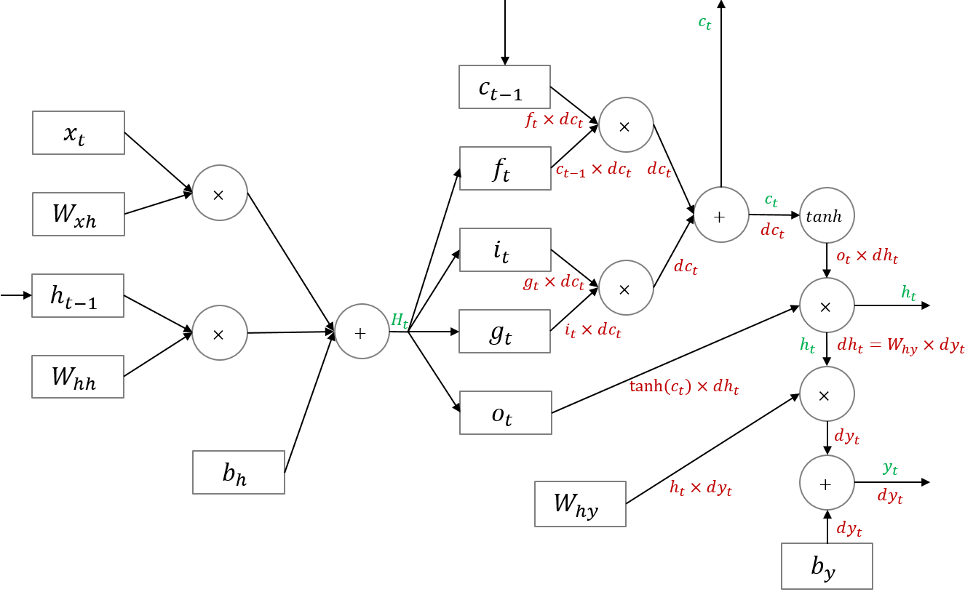
Long Short-Term Memory(LSTM)
Back propagation through differentiation
Back propagation

Slide 10
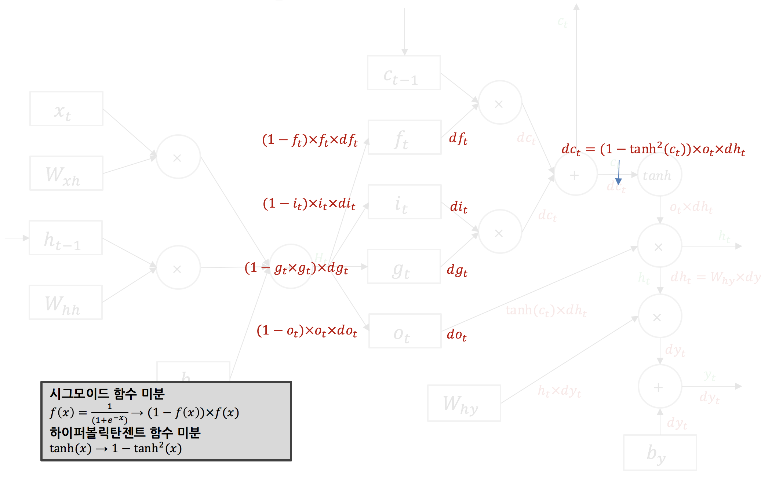
Long Short-Term Memory(LSTM)
Back propagation

Slide 11
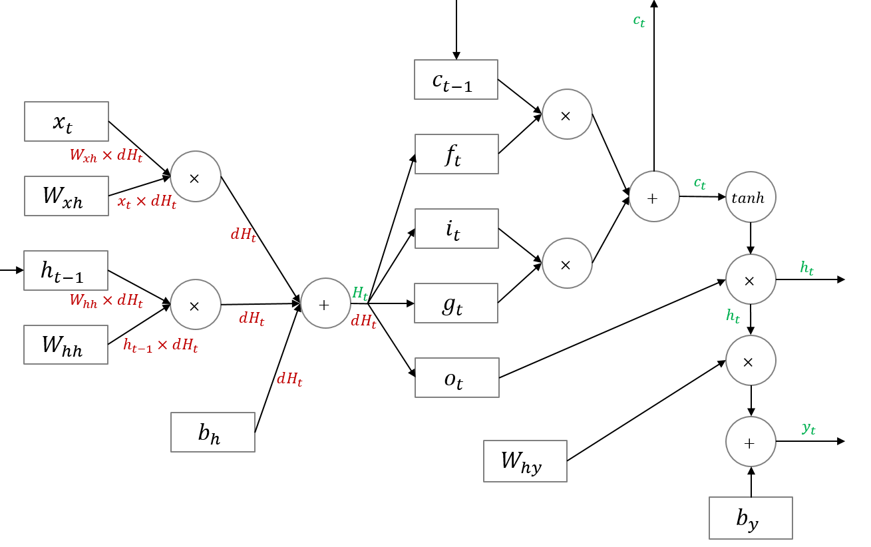
Long Short-Term Memory(LSTM)
Back propagation

Slide 12
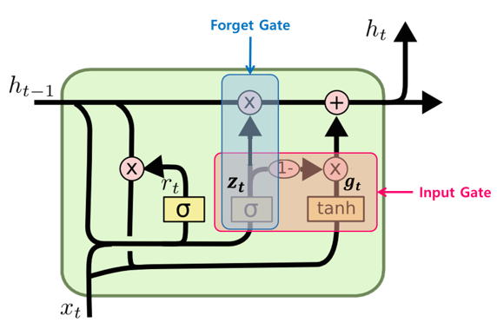
Gated Recurrent Unit(GRU)
Simplified version of LSTM cell
LSTM
GRU

Slide 13
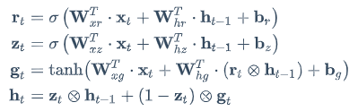
Gated Recurrent Unit(GRU)
Simplified version of LSTM cell

